Slide 1
2024 Street and Utility Reconstruction
City of Stoughton
Project Information Meeting
Open House
February 12, 2024

Slide 2
Introduction of Project Contacts
Brett Hebert, Director of Public Works, City of Stoughton
Sue Eddy, Engineering Technician, City of Stoughton
John Halverson, Street Superintendent, City of Stoughton
Jill Weiss, Utilities Director, Stoughton Utilities
Kyle White, Design/Construction Representative, Strand Associates, Inc.
Pat Current , Design/Construction Representative, Strand Associates, Inc.
Mark Fisher, Project Manager, Strand Associates, Inc.

Slide 3
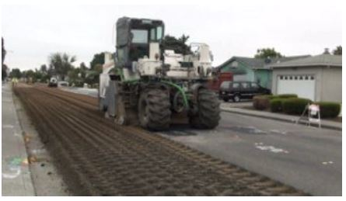
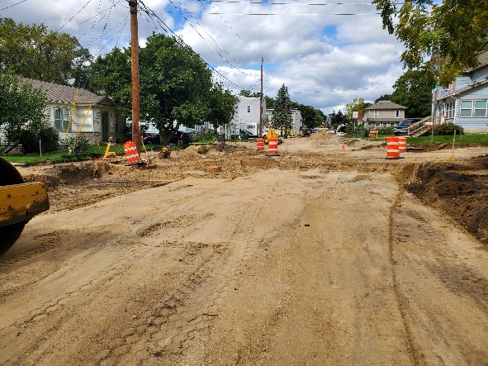
Summary of Projects to be Discussed
Street Pulverization Projects
Greig Trail (Lincoln Ave to Van Buren St)
Johnson Street (Roby Rd to Page St)
Street Reconstruction Projects
West South Street (Van Buren St to
Page St)
Madison Street (South St to Jefferson St)
(Storm Sewer only)

Slide 4
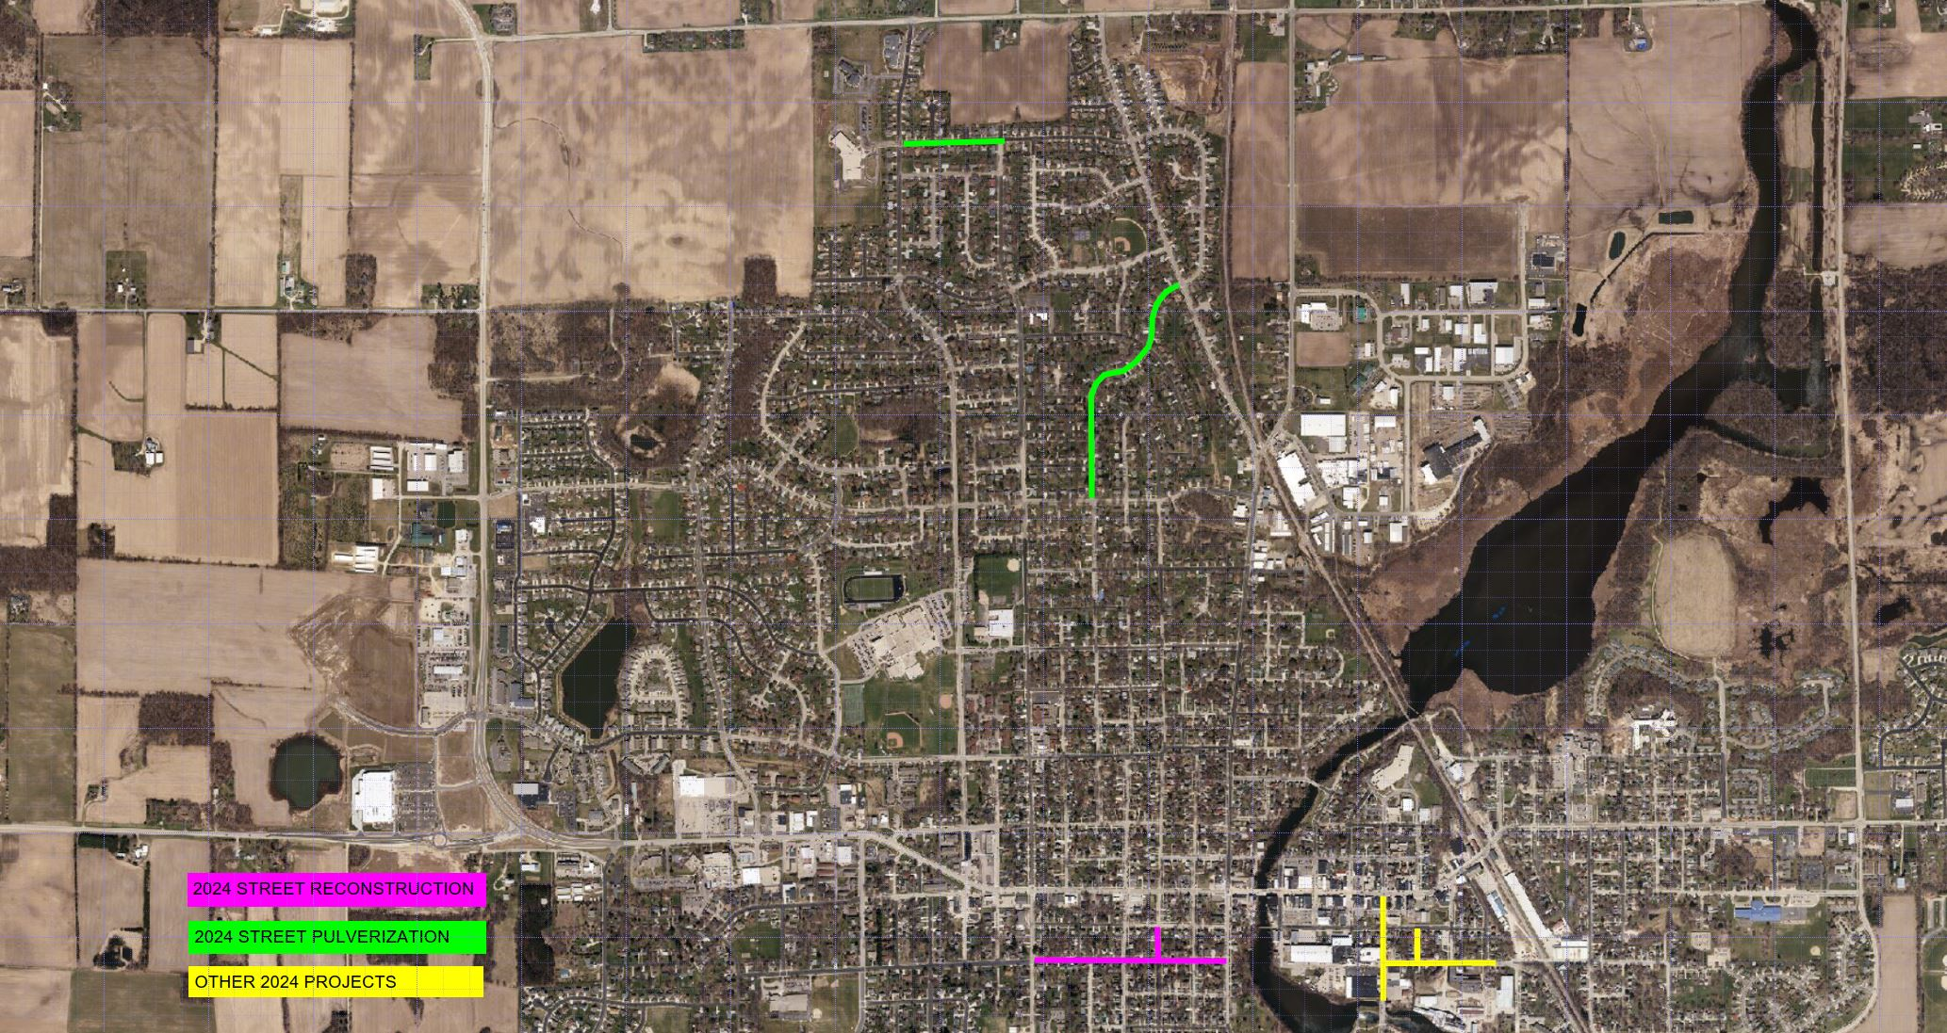
Overall Project Locations Map

Slide 5
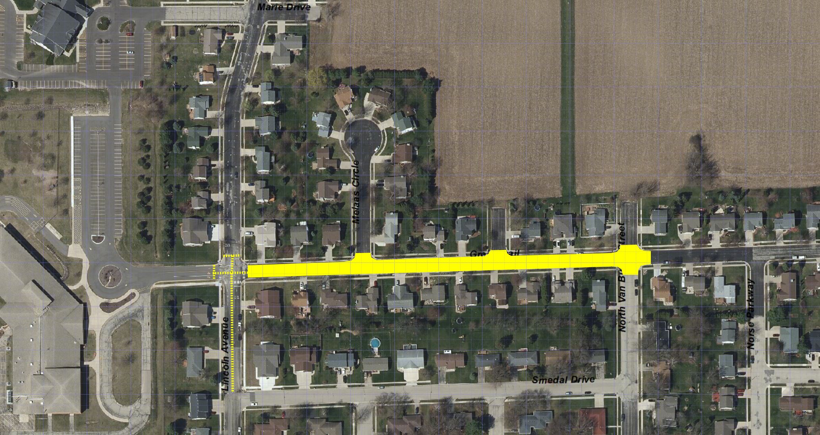
Greig Trail - Project Location Map

Slide 6
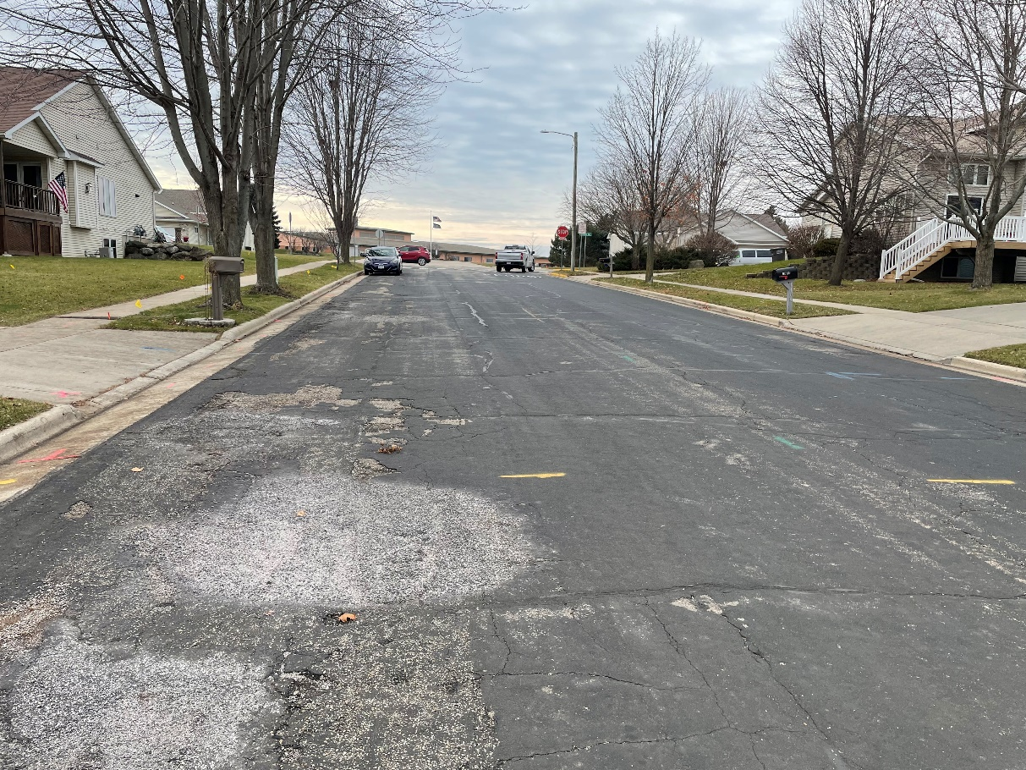
Project Scope – Greig Trail
Install Storm Sewer to address drainage concerns on Lincoln Avenue (2025)
“Spot” replace defective curb and gutter and sidewalk sections.
Replace curb ramps to meet ADA standards.
Pulverize and re-grade existing pavement and place new asphalt pavement.

Slide 7
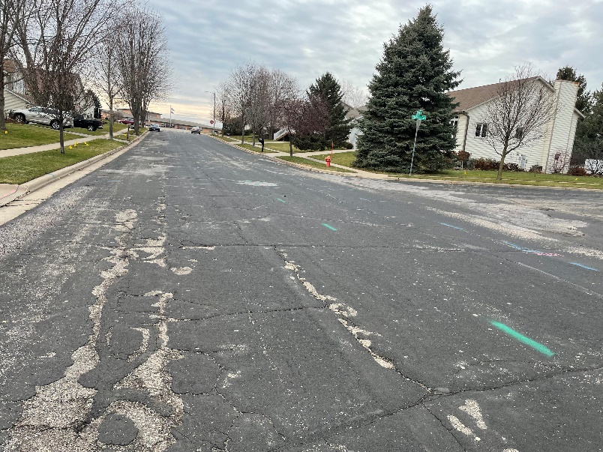
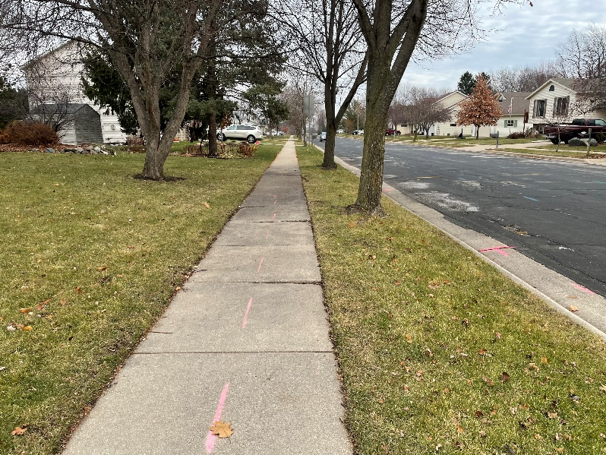
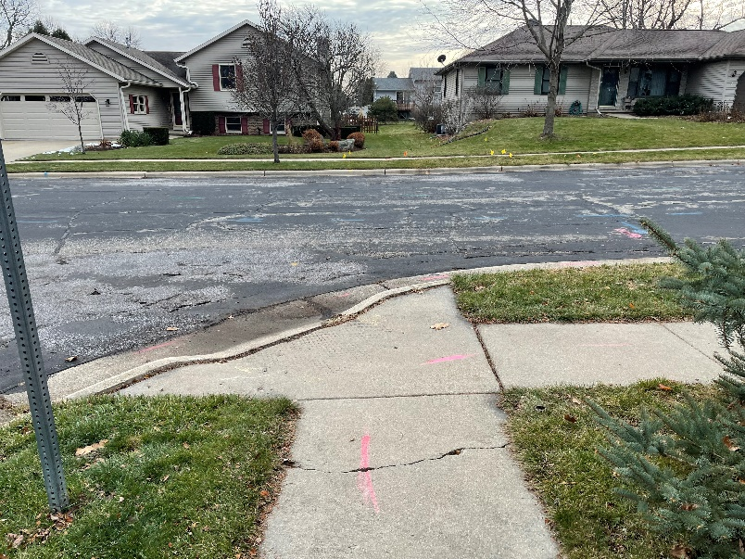
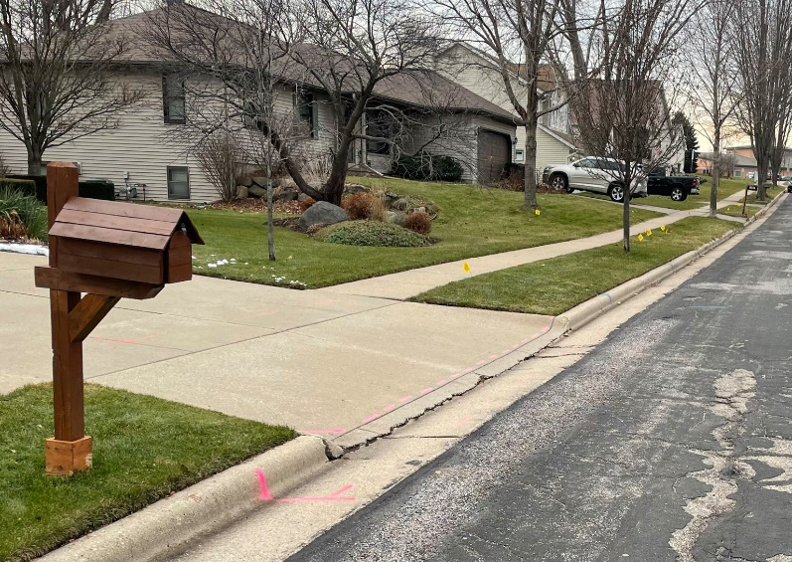
Pavement Deterioration
Defective Sidewalk
Non-Compliant Curb Ramps
Defective Driveways
Greig Trail – Existing Conditions

Slide 8
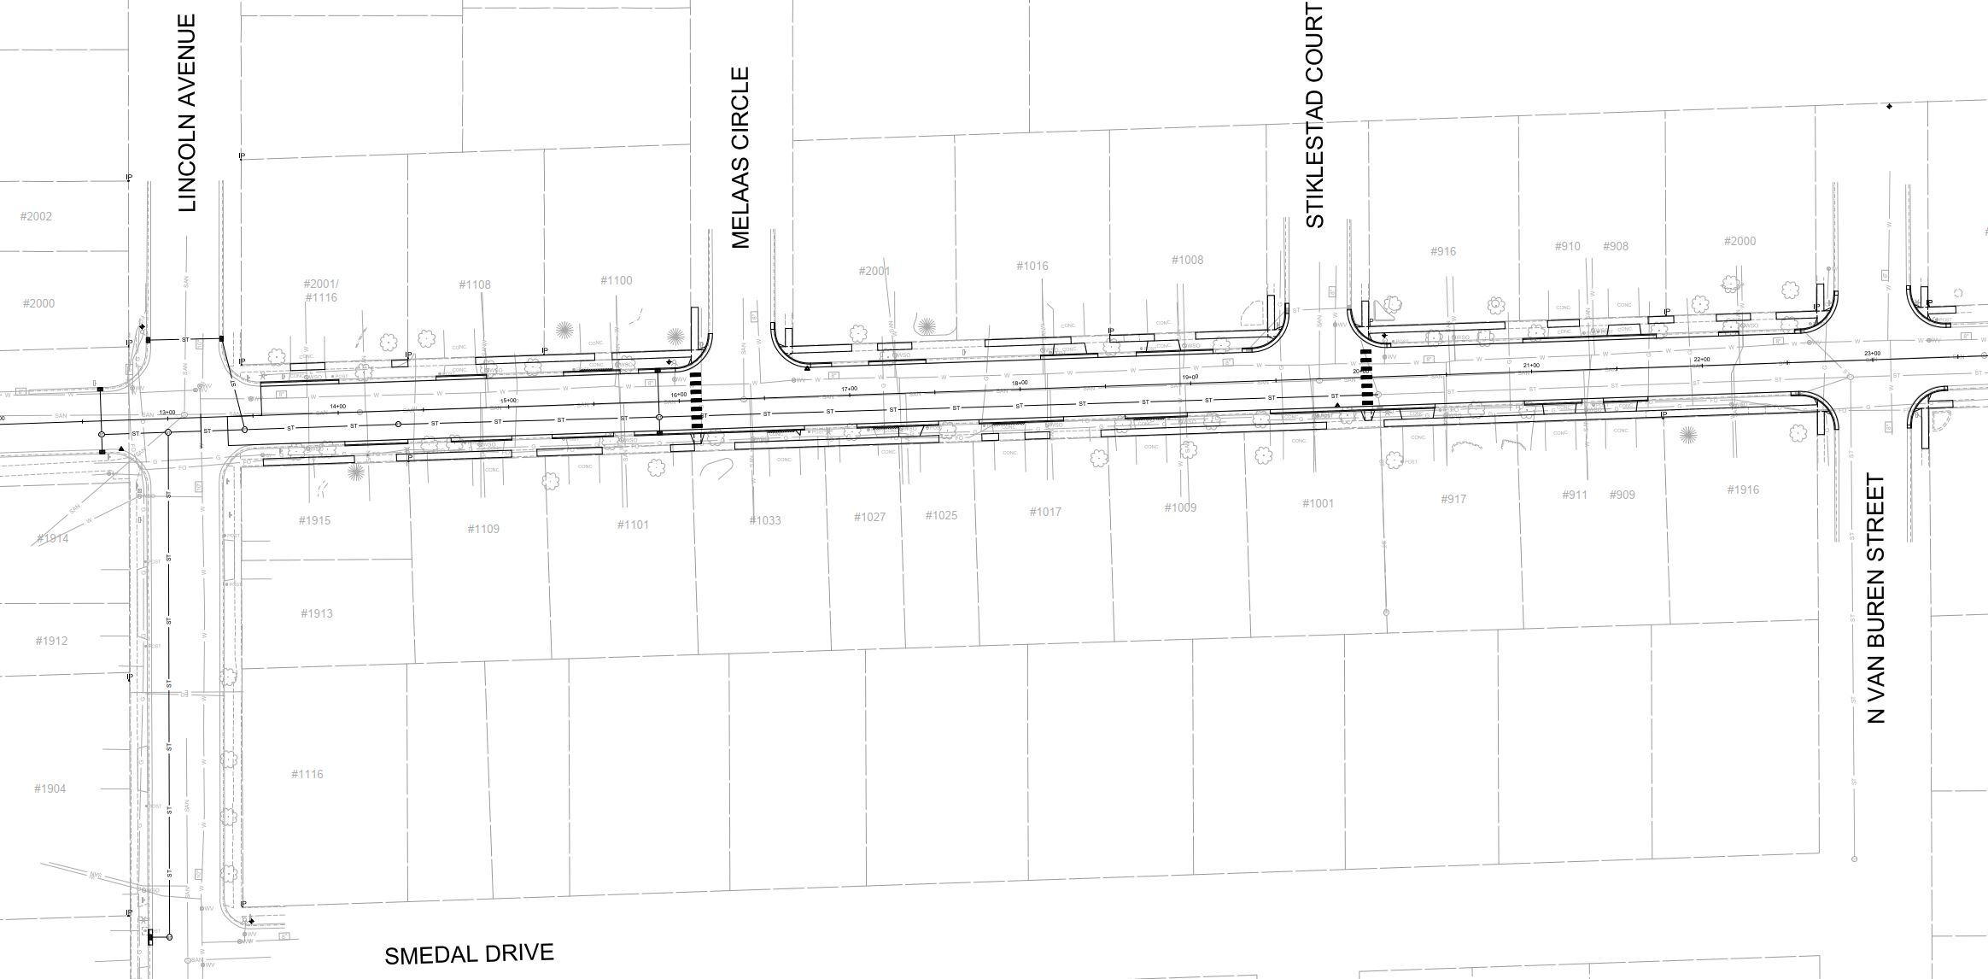
Proposed Design

Slide 9
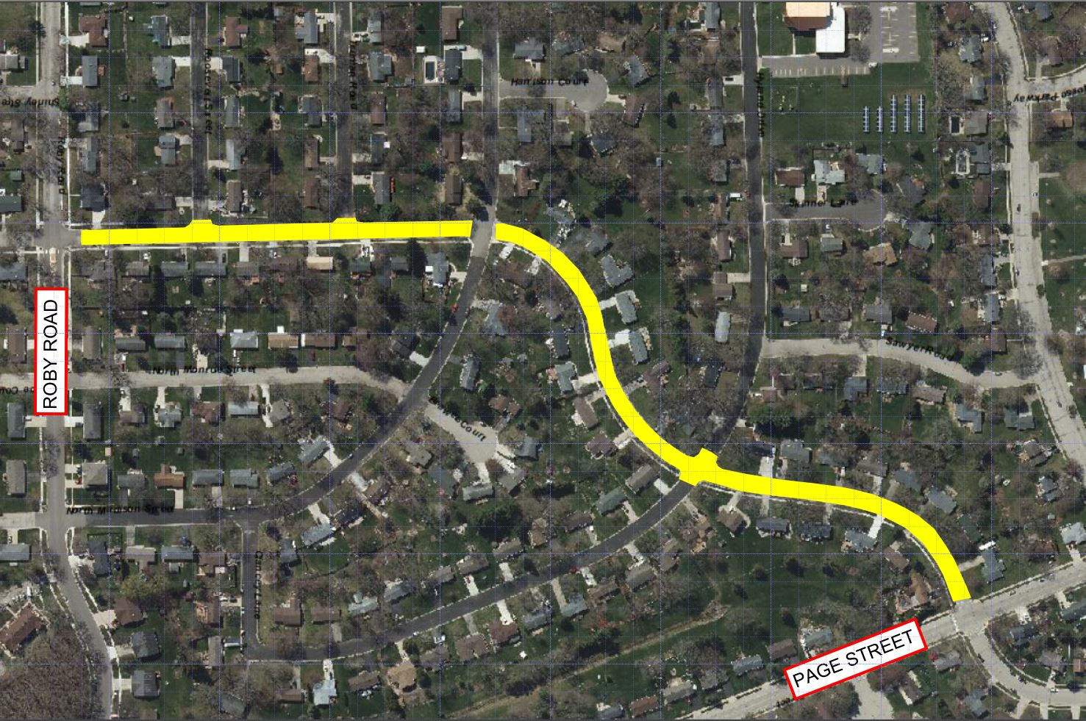
Johnson Street - Project Location Map

Slide 10
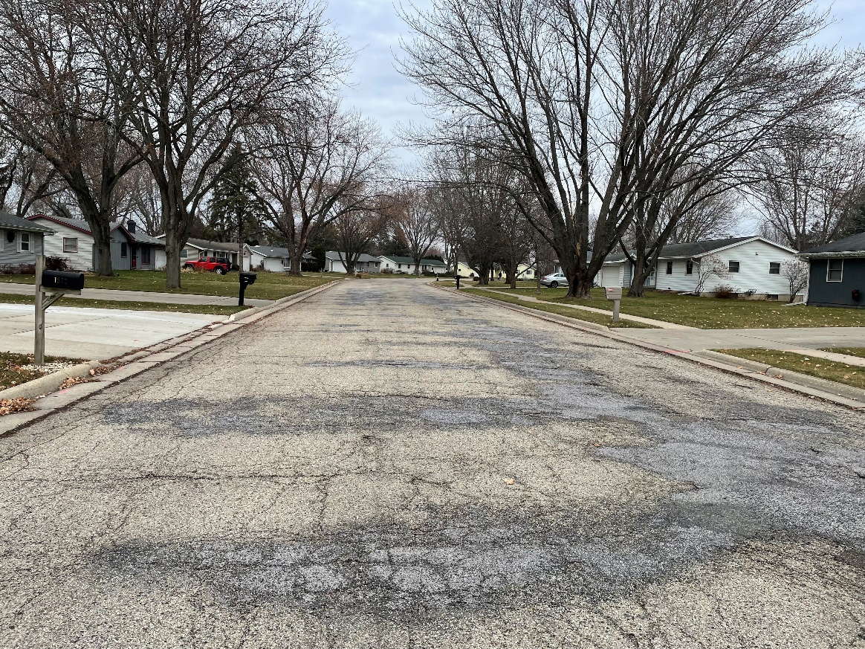
Project Scope – Johnson Street
“Spot” replace defective curb and gutter and sidewalk sections.
Replace curb ramps to meet ADA standards.
Construct valley gutters at select intersections for drainage.
Pulverize and re-grade existing pavement and place new asphalt pavement.

Slide 11
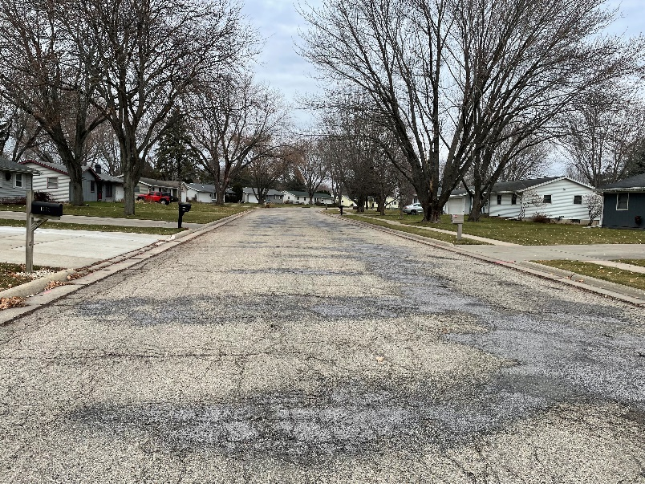
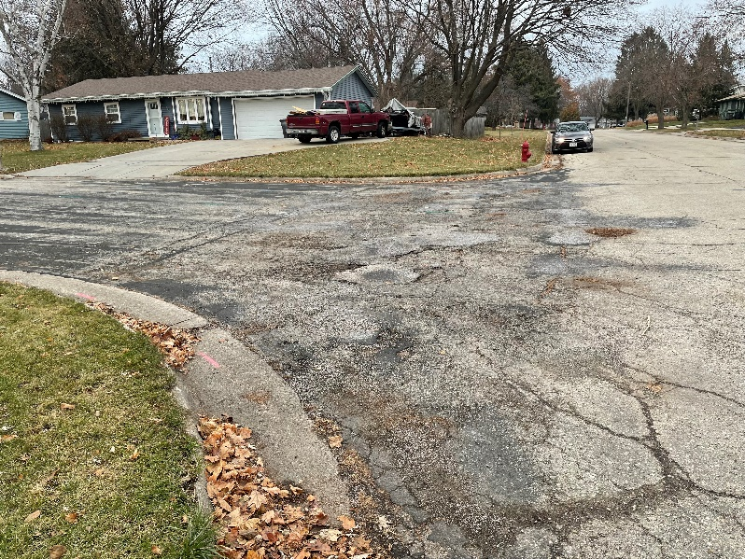
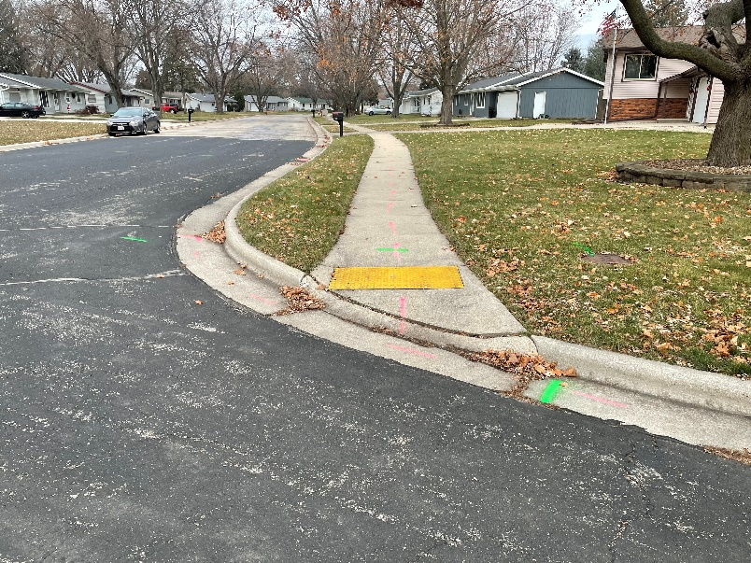
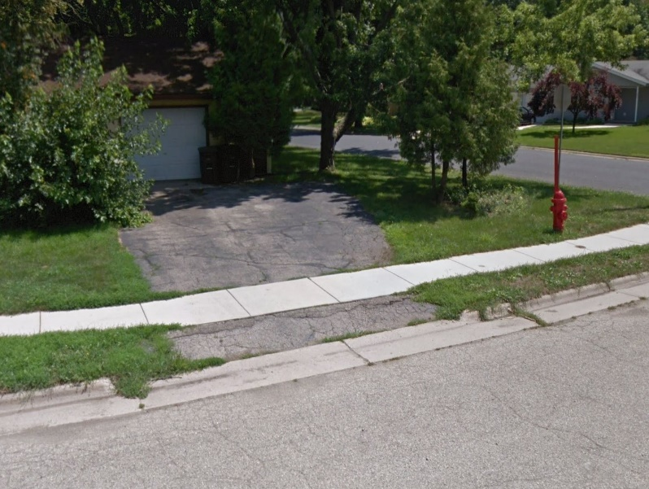
Pavement Deterioration
Poor Intersection Drainage
Non-Compliant Curb Ramps
Defective Driveways
Johnson Street – Existing Conditions

Slide 12
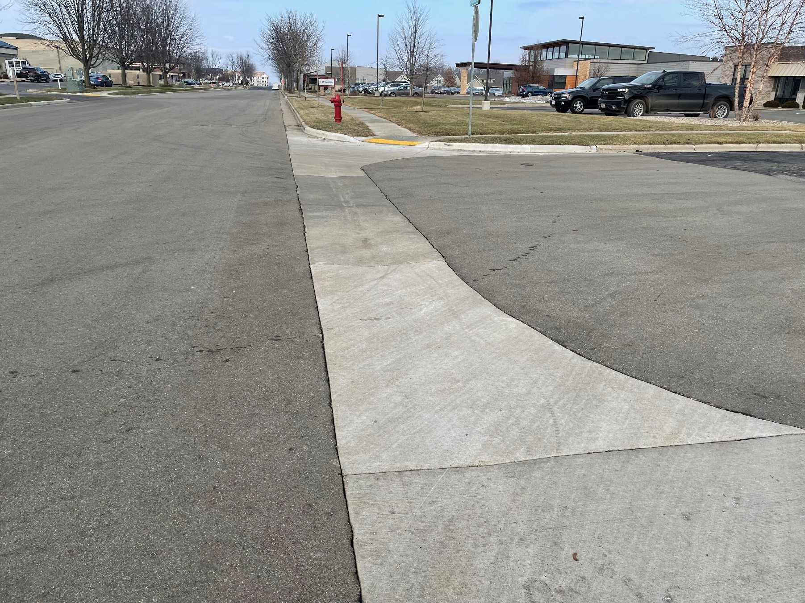
Typical Valley Gutter

Slide 13
Proposed Design – Johnson Street

Slide 14
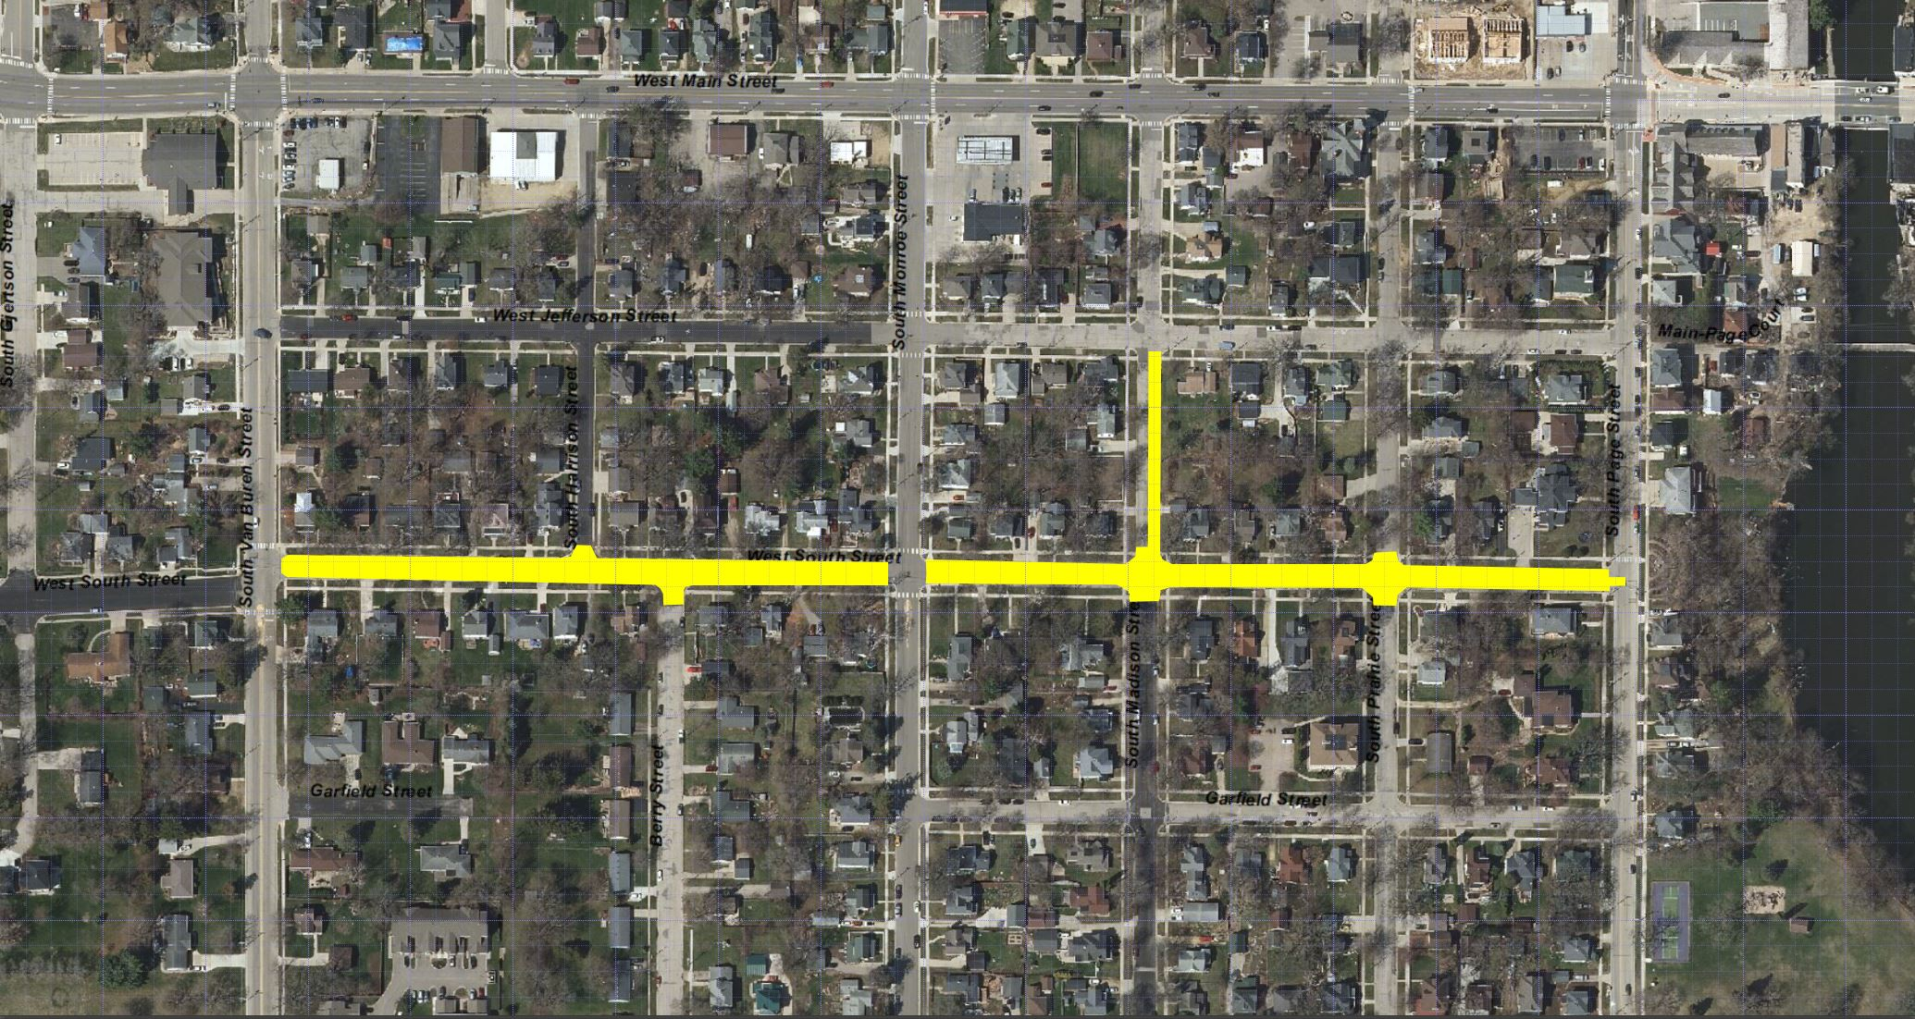
West South Street - Project Location Map

Slide 15
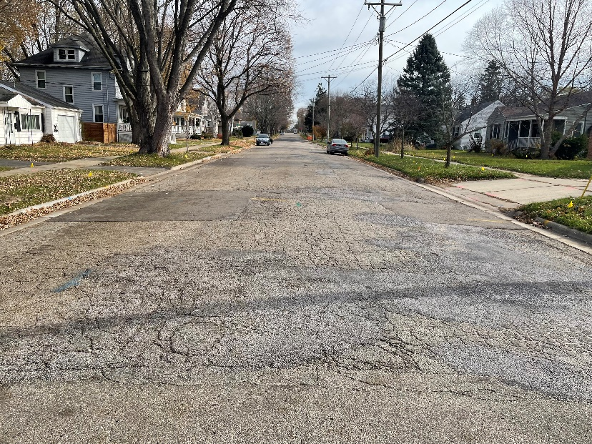
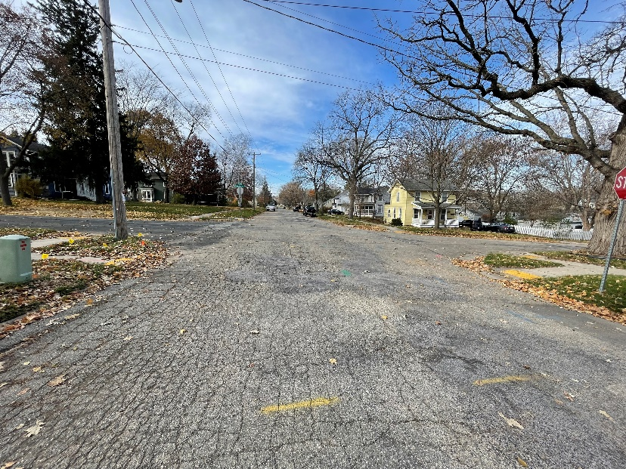
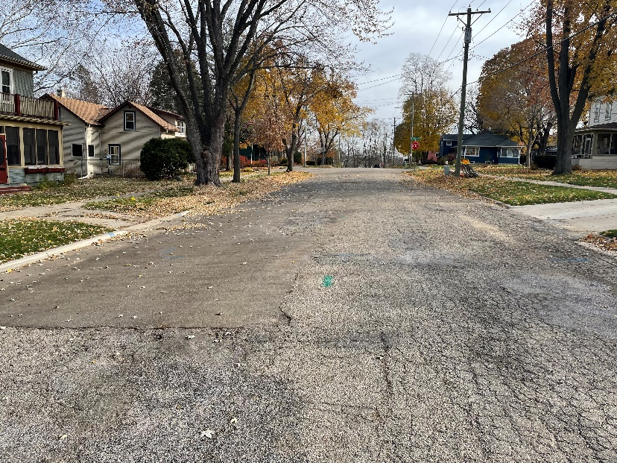
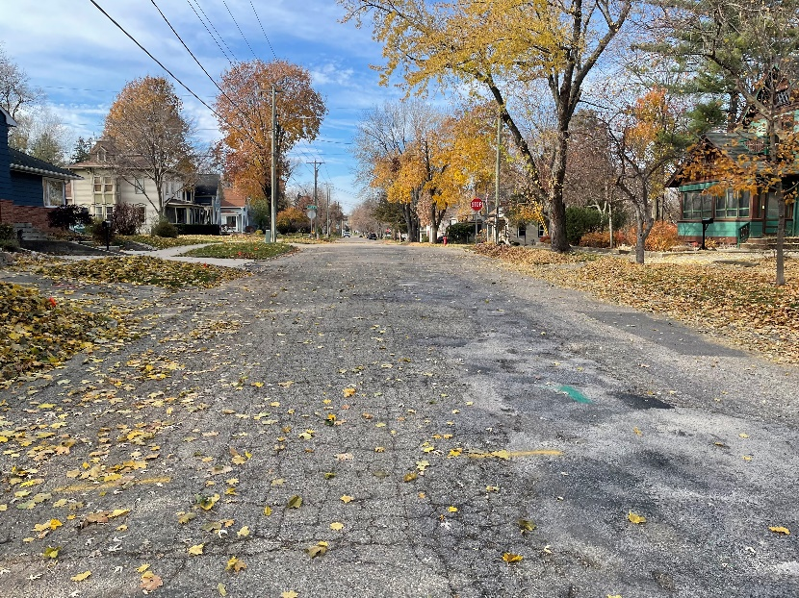
West South Street – Pavement Deterioration

Slide 16
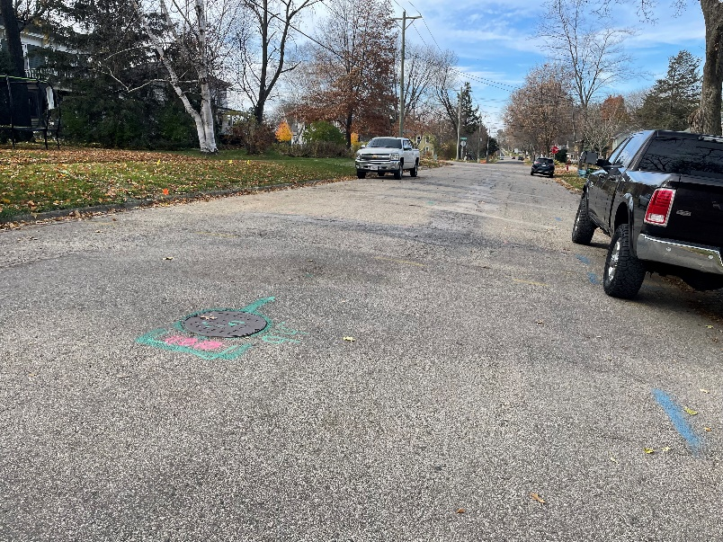
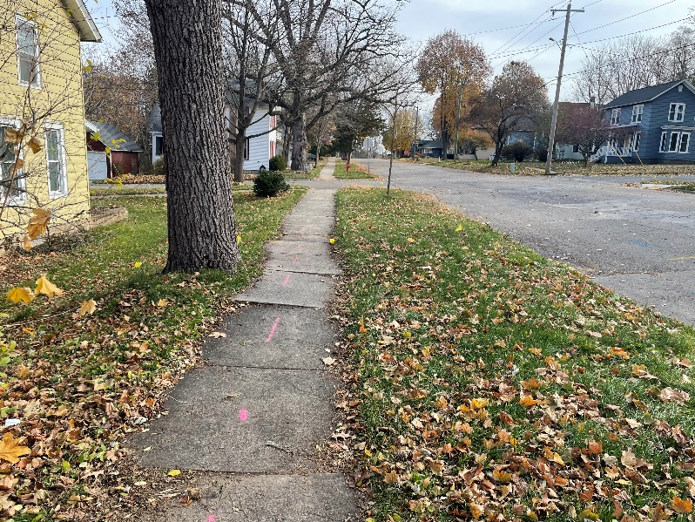
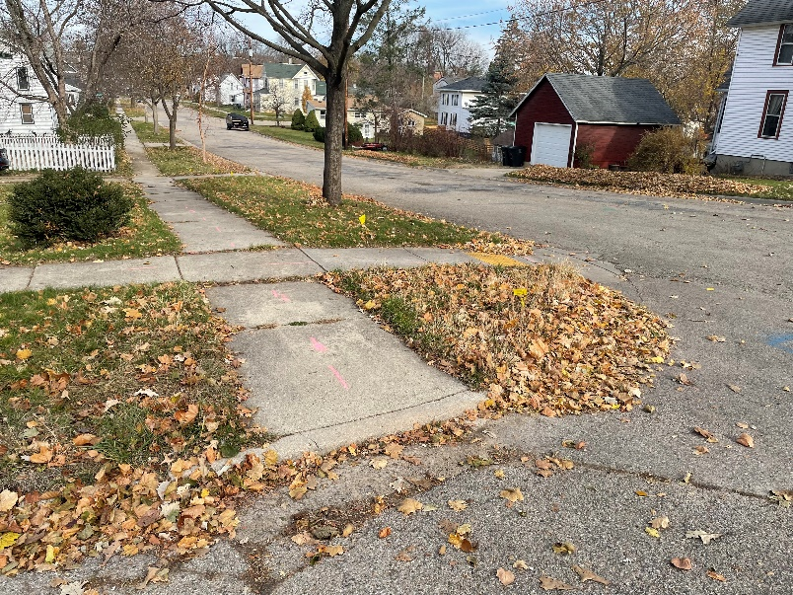
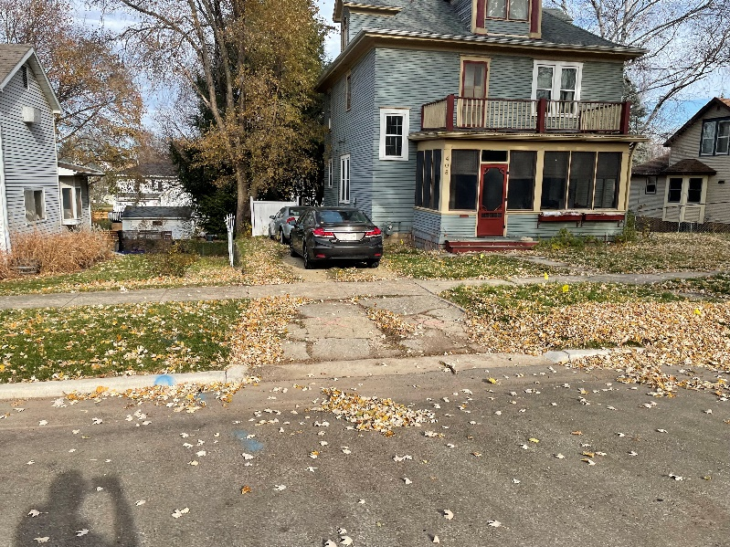
Steep Pavement Cross Slope
Defective Sidewalks
Non-Compliant Curb Ramps
Defective Driveways
West South Street – Existing Conditions

Slide 17
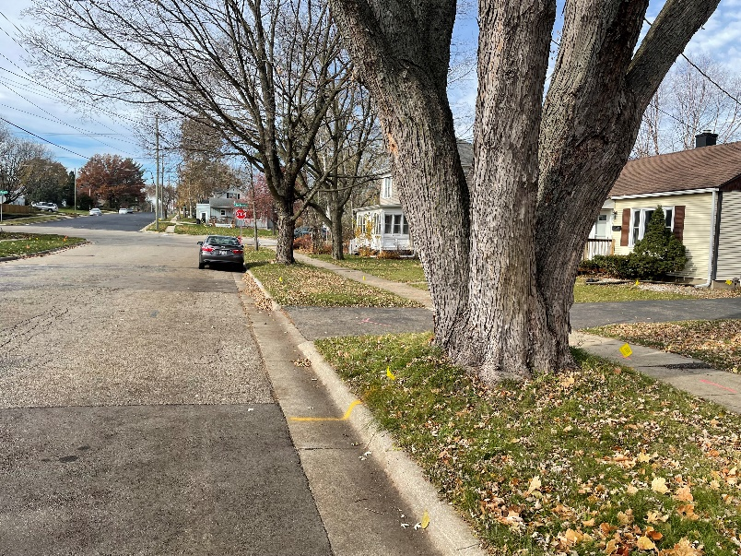
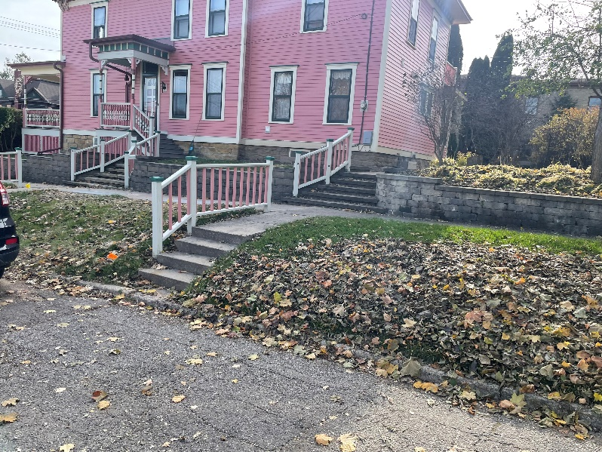
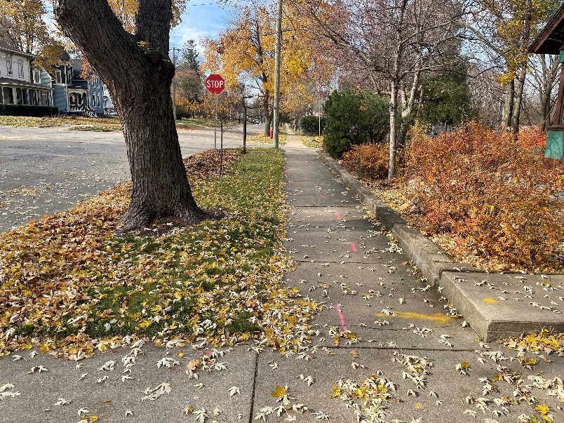
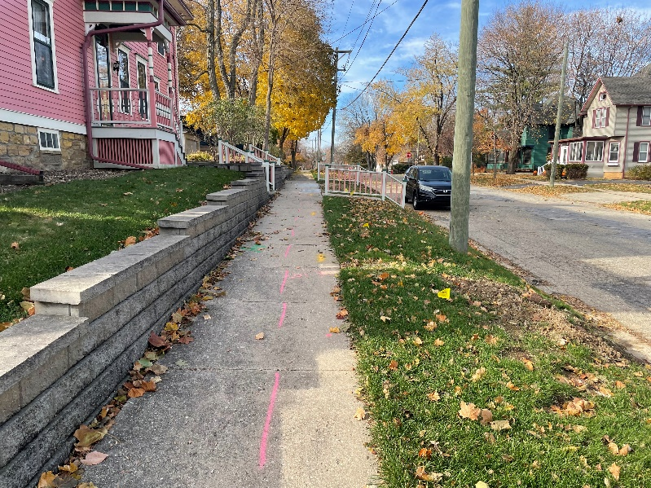
Non-Desirable Terrace Trees
Existing Steps
Existing Retaining Walls
Existing Retaining Walls
West South Street – Existing Conditions

Slide 18
Project Scope – West South Street
Complete reconstruction of the street, curb and gutter, sidewalk, and driveway aprons between Van Buren Street and Page Street. The new street width will match the existing street width.
Street design is complicated by steep topography and difference in elevation from side-to-side of the street.
New ADA compliant curb ramps will be constructed.
New storm sewer will be installed, including storm sewer on Madison Street between South Street and Jefferson Street.
New sanitary sewer and laterals will be installed.
Redundant water main will be removed and select water system components will be replaced.
Some tree removal is required for the project, but trees will be replaced after construction.
Existing retaining walls will be protected. Steps within the right-of-way
will be replaced or removed.

Slide 19
Proposed Design - Overall

Slide 20
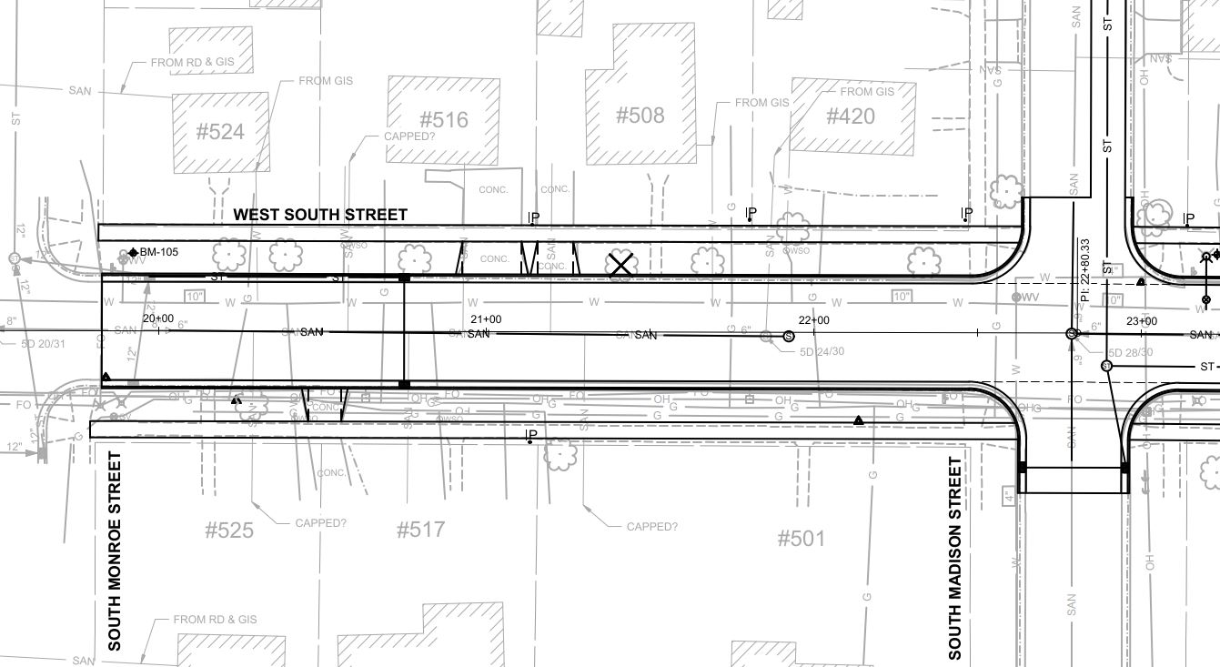
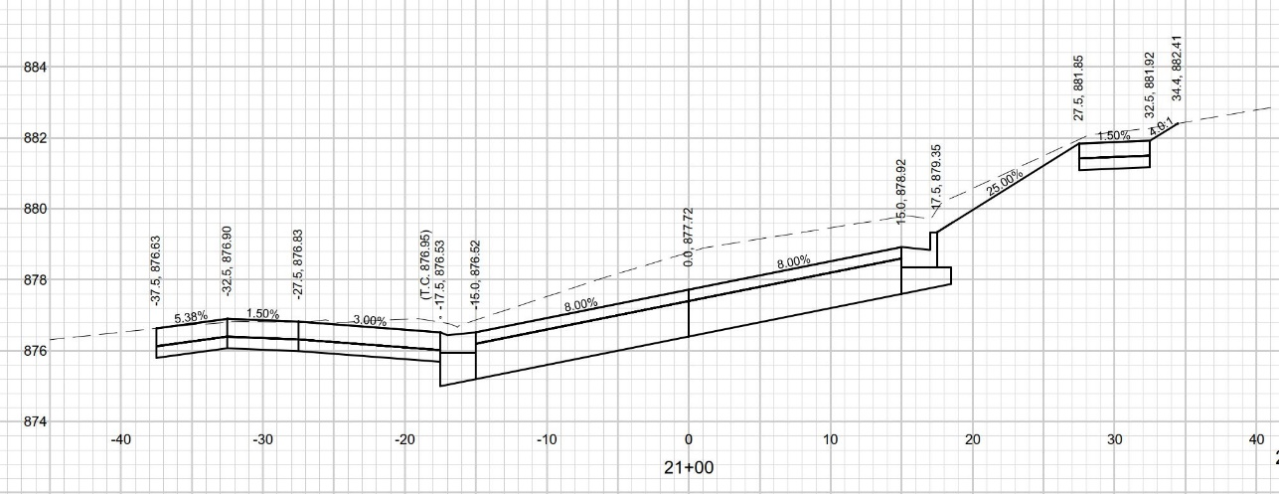
Proposed Design

Slide 21
Project Construction Schedule
Pulverization Project
The project will move into the bidding phase in late February and bids will be opened in mid-March. City committees/council will consider the contracts in late March.
Construction is anticipated to begin in early to mid-May.
Construction should not affect Syttende Mai or other events.
Construction on Greig Trail will be limited to concrete replacements until the school year is complete.
Construction completion is anticipated in August.
Reconstruction Project
The project will likely move into the bidding phase in late February and bids will be opened in mid-March. City committees/council will consider the contracts in April.
Construction will likely begin in late May.
Construction should not affect Syttende Mai or other events.
Construction completion is anticipated in September

Slide 22
Common Questions / Discussion Items
Advance notice of planned water service outages will be provided whenever possible.
The streets will be closed to through traffic during construction. Access will be provided for emergency vehicles and local traffic.
Access to driveways during non-work hours (nights/weekends) will be required by the contract. Vehicular access to driveways will be subject to concrete cure times (10-14 days).
Refuse collection will be coordinated by the contractor.

Slide 23
Common Questions / Discussion Items
Road closures will be posted/signed, but formal detours will not be implemented.
Where terrace trees are removed with the project, new trees will be planted at the City’s cost. Contact the City Forester with questions or for additional information.
Weekly construction updates will be posted on the city website and made available by e-mail.
A preconstruction neighborhood open house will be held with the contractor before construction begins. Additional details will be provided a later date.

Slide 24
Special Assessments
The city will follow its special assessment policy. Sidewalk is assessed at 50% to the property owner. Replacement curb and gutter is assessed at 50% to the property owner. Carriage walks/steps and driveway aprons and certain property–specific items of work are assessed at 100% to the property owner.
Property owners can request that carriage walks and steps not be replaced to avoid special assessment charges for the carriage walk.
Preliminary assessment estimates and public hearing information will be sent to property owners in the coming weeks.

Slide 25
Questions and Answers

